Slide 1
Smart Card Shuffler
Team 10: Krish, Craig, Johnny, Brendan

Slide 2
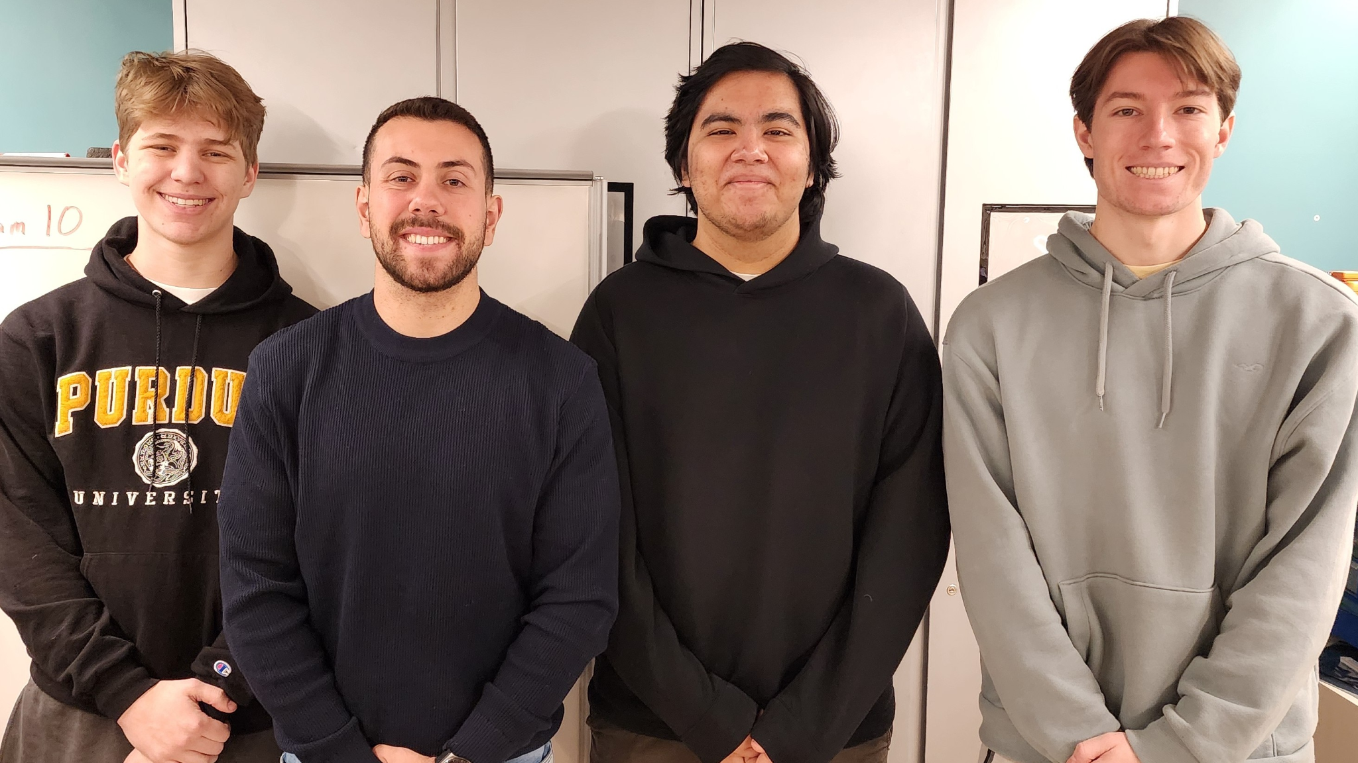
Meet our Team
I am the Team Lead
I am the Systems Lead
I am the Software Lead
I am the Electrical Lead

Slide 3
Presentation Agenda
Major Components
Packaging Design
Project Overview
Block Diagram

Slide 4
Presentation Agenda
Software Development Status
PCB
Layout
Electrical Schematic
Prototyping Progress

Slide 5
Presentation Agenda
Q&A
Project Timeline
Done!

Slide 6
Project Overview

Slide 7
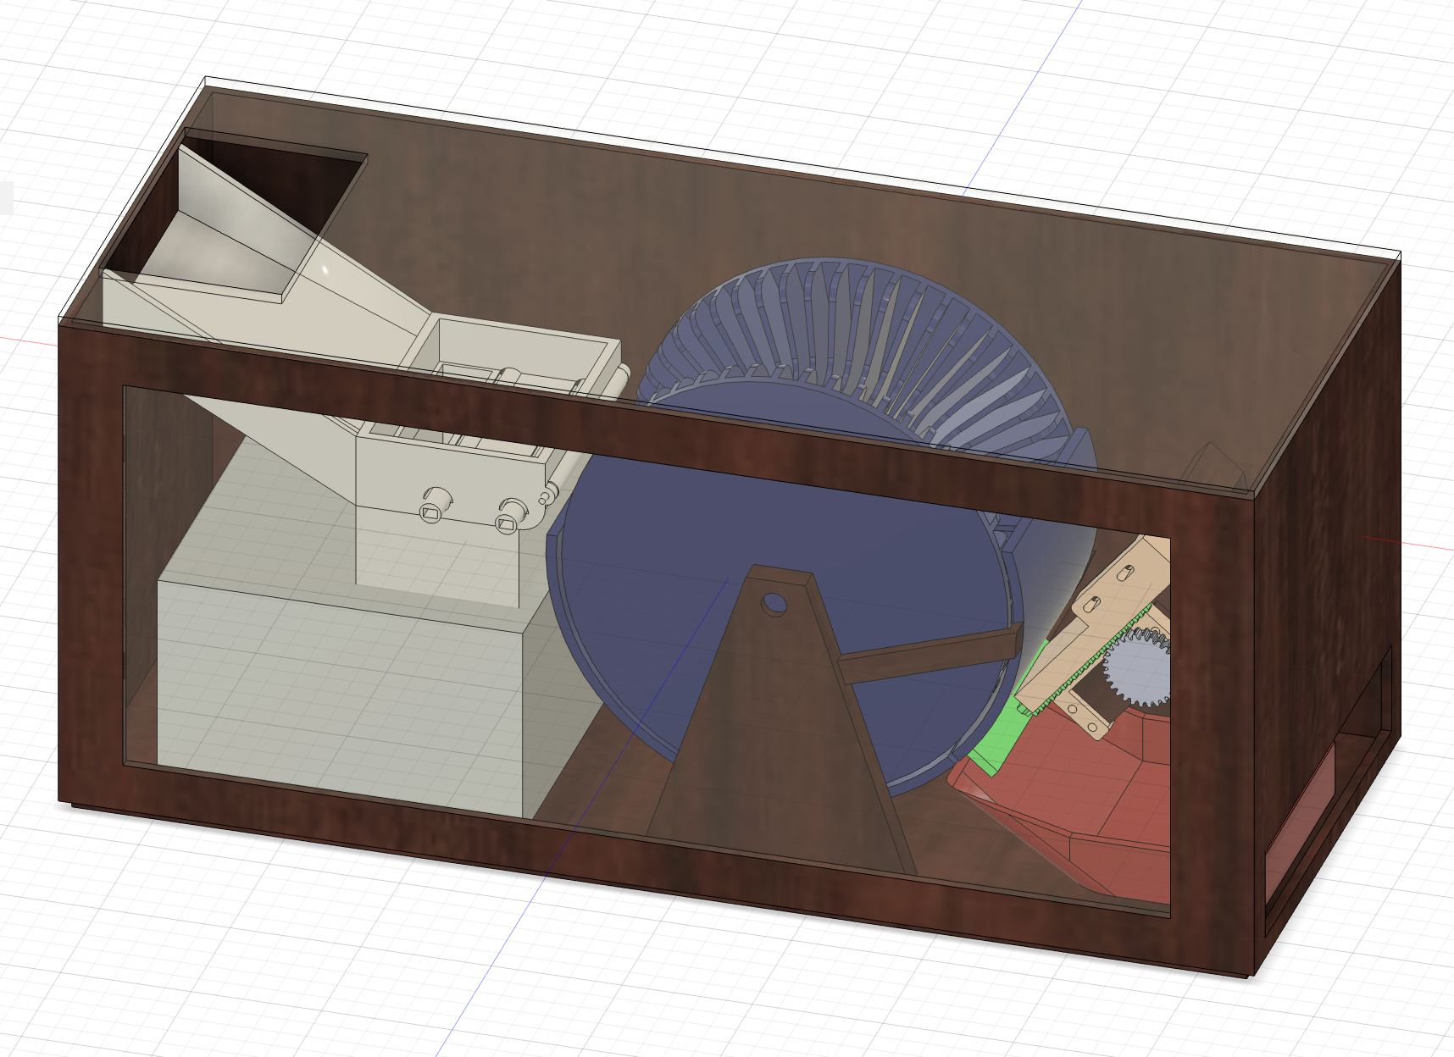
The Smart Card Shuffler
Differentiation: Most card shufflers only do random shuffles
Some “smart” shufflers exist, but are over $5K, and are only sold to casinos.
Take a standard deck of 52 cards
Reorder it based on the user’s selected mode: Poker, Random, or Custom.
The user interacts with a Flutter-based mobile app,
Connects to the Raspberry Pi via BLE to configure the shuffle mode
So you can use this device to give yourself any hand in poker, reorder the deck in any order, or do an actual random shuffle
Notes:
Krish

Slide 8
PSDRs
An ability for the microcontroller to interface with a stepper motor driver to move stepper motor in precise increments
An ability for the microcontroller to communicate with Raspberry Pi over a UART connection.
An ability for the microcontroller to control brushed DC motors with certain speed and direction to feed 1 card
A mobile application that can be used to select desired order of cards and communicate with Raspberry Pi via Bluetooth
An algorithm that determines an order of loading/unloading cards optimized for time given the original order of deck and parameters concerning shuffled order of cards
Stretch PSDRs
Provide greater functionality through phone application for Poker screen, to allow for continuous game modes, simulating game feature and Poker modifications
Implementation of STM32 firmware using an RTOS to guarantee smooth motor control and timely communication
Notes:
Brendan

Slide 9
Major Components

Slide 10
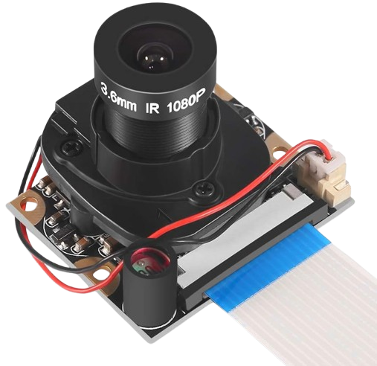
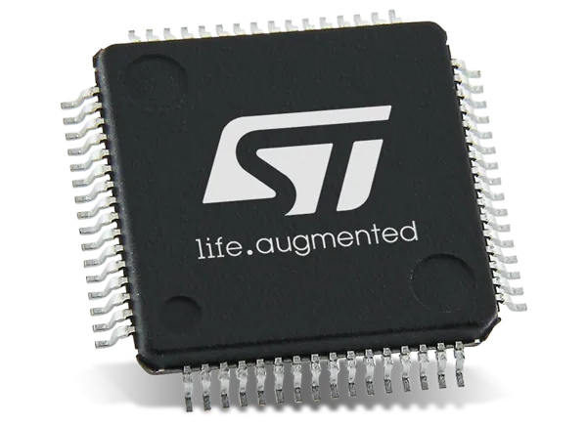
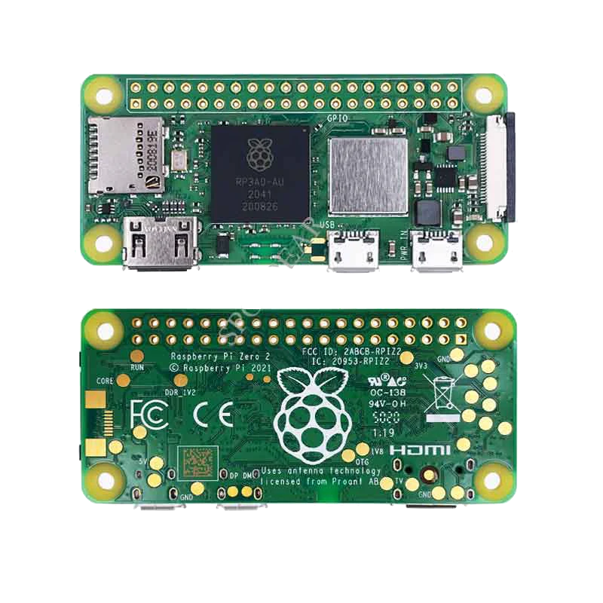
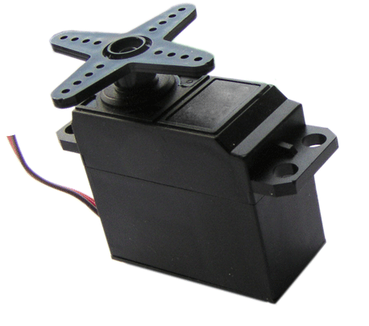
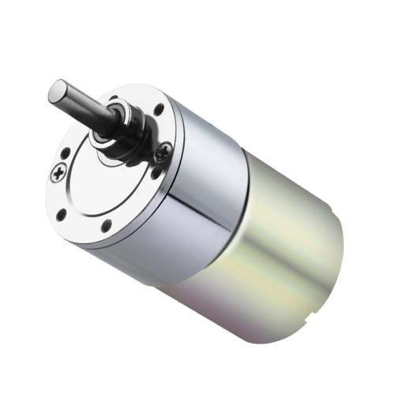
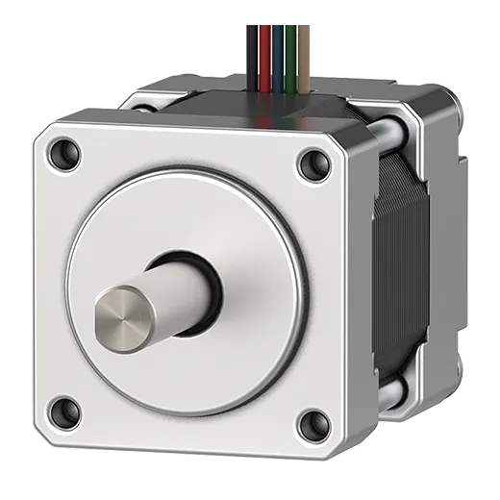
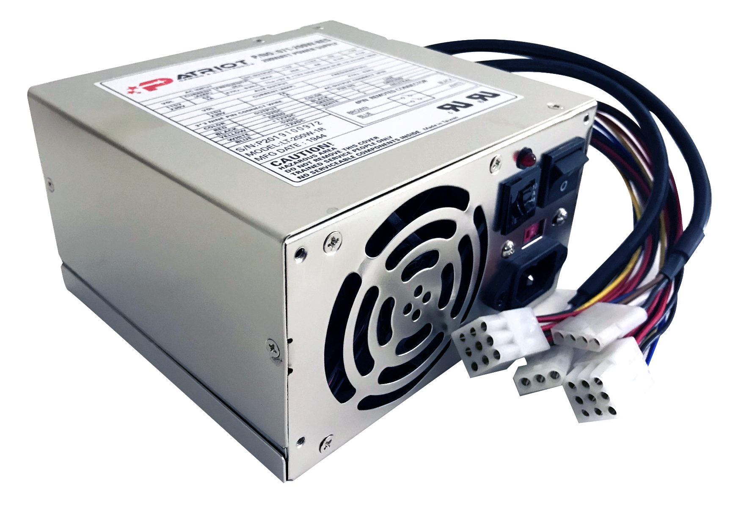
Major Components
Notes:
Maybe change order here so components light up in order

Slide 11
Major Components

Slide 12
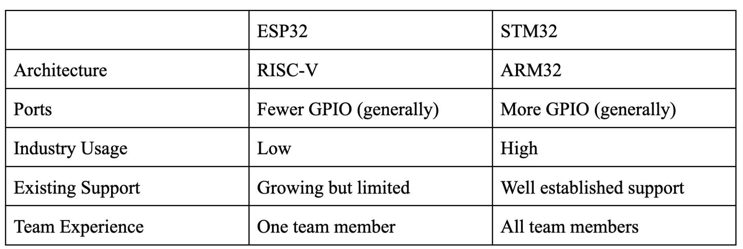
STM32 vs ESP32
Notes:
Brendan

Slide 13
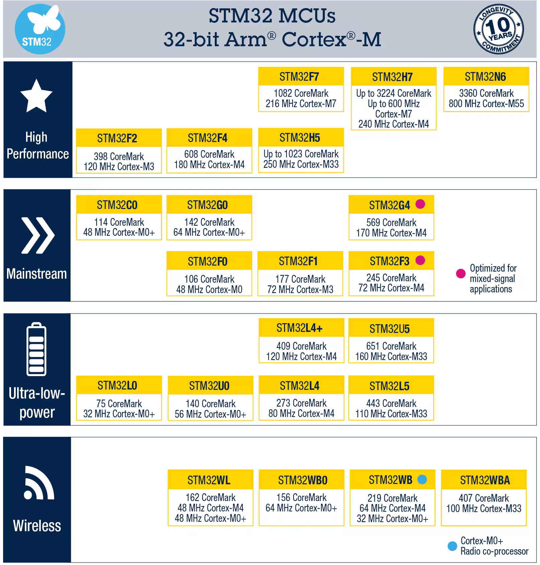
Which STM32?
Notes:
Brendan

Slide 14
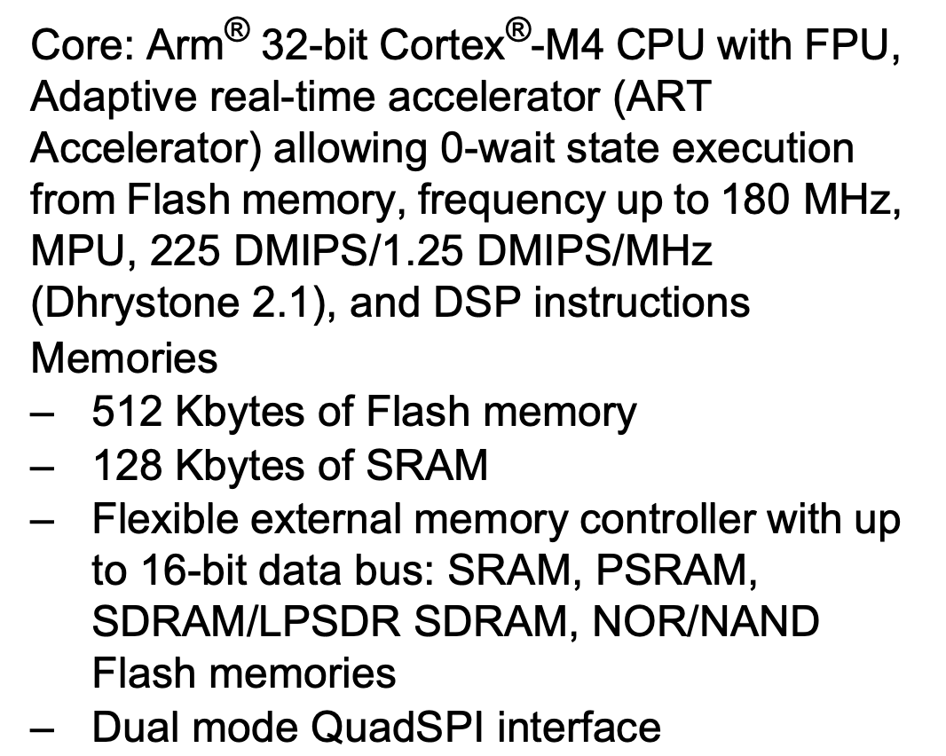
STM32 F446RET
The team selected the STM32F4 for its high performance within the STM32 F-series, featuring a 180MHz clock speed, ensuring sufficient processing power while maintaining familiarity with the STM32 ecosystem
Important Features:
512Kb Flash Memory
128 Kb SRAM
Up to 111 I/O ports
Notes:
Brendan

Slide 15
Major Components

Slide 16
Raspberry Pi Zero 2W
Device | Raspberry Pi Zero 2 W | Raspberry Pi 4 | STM32WB55RG | Arduino Uno R4 Wifi
Price ($) | 15 | 35 | 36 | 22
Complexity (Scale of 10, 1 highest) | 6 | 7 | 3 | 5
Compatibility (Scale of 10, 10 most compatible) | 8 | 8 | 8 | 4
Size (Scale of 10, 10 smallest) | 8 | 3 | 9 | 3
Programming Language Compatibility | Many+ | Many+ | C | Arduino
Documentation (Scale of 10) | 8 | 9 | 6 | 8
Use Case: Run algorithm to determine order, Connect to app via Bluetooth, Camera Module and Image Processing
Notes:
Krish

Slide 17
Major Components

Slide 18
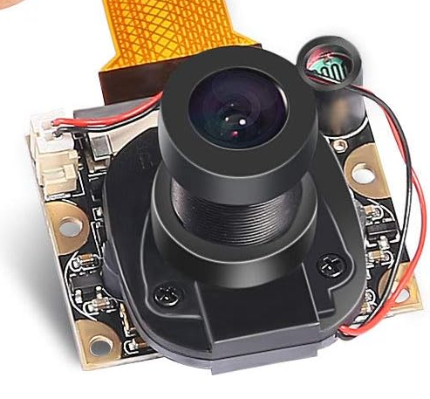
Raspberry Pi 3 Model B+ Camera Module
5 Megapixel Camera
Adjustable Focus Lens
Capable of 1080p 30 fps
Automatic IR-CUT Camera (Night Vision)
$15.99 (Cheap)
Use Case: Identify card
Use with Arducam for Raspberry Pi Zero Camera Cable Set
Alternatives considered: Raspberry Pi Camera 3 (Too expensive), Innomaker Raspberry Pi Camera Module (Worse reviews), Raspberry Pi Camera Module 3 Wide (Expensive)
Notes:
Krish

Slide 19
Major Components

Slide 20
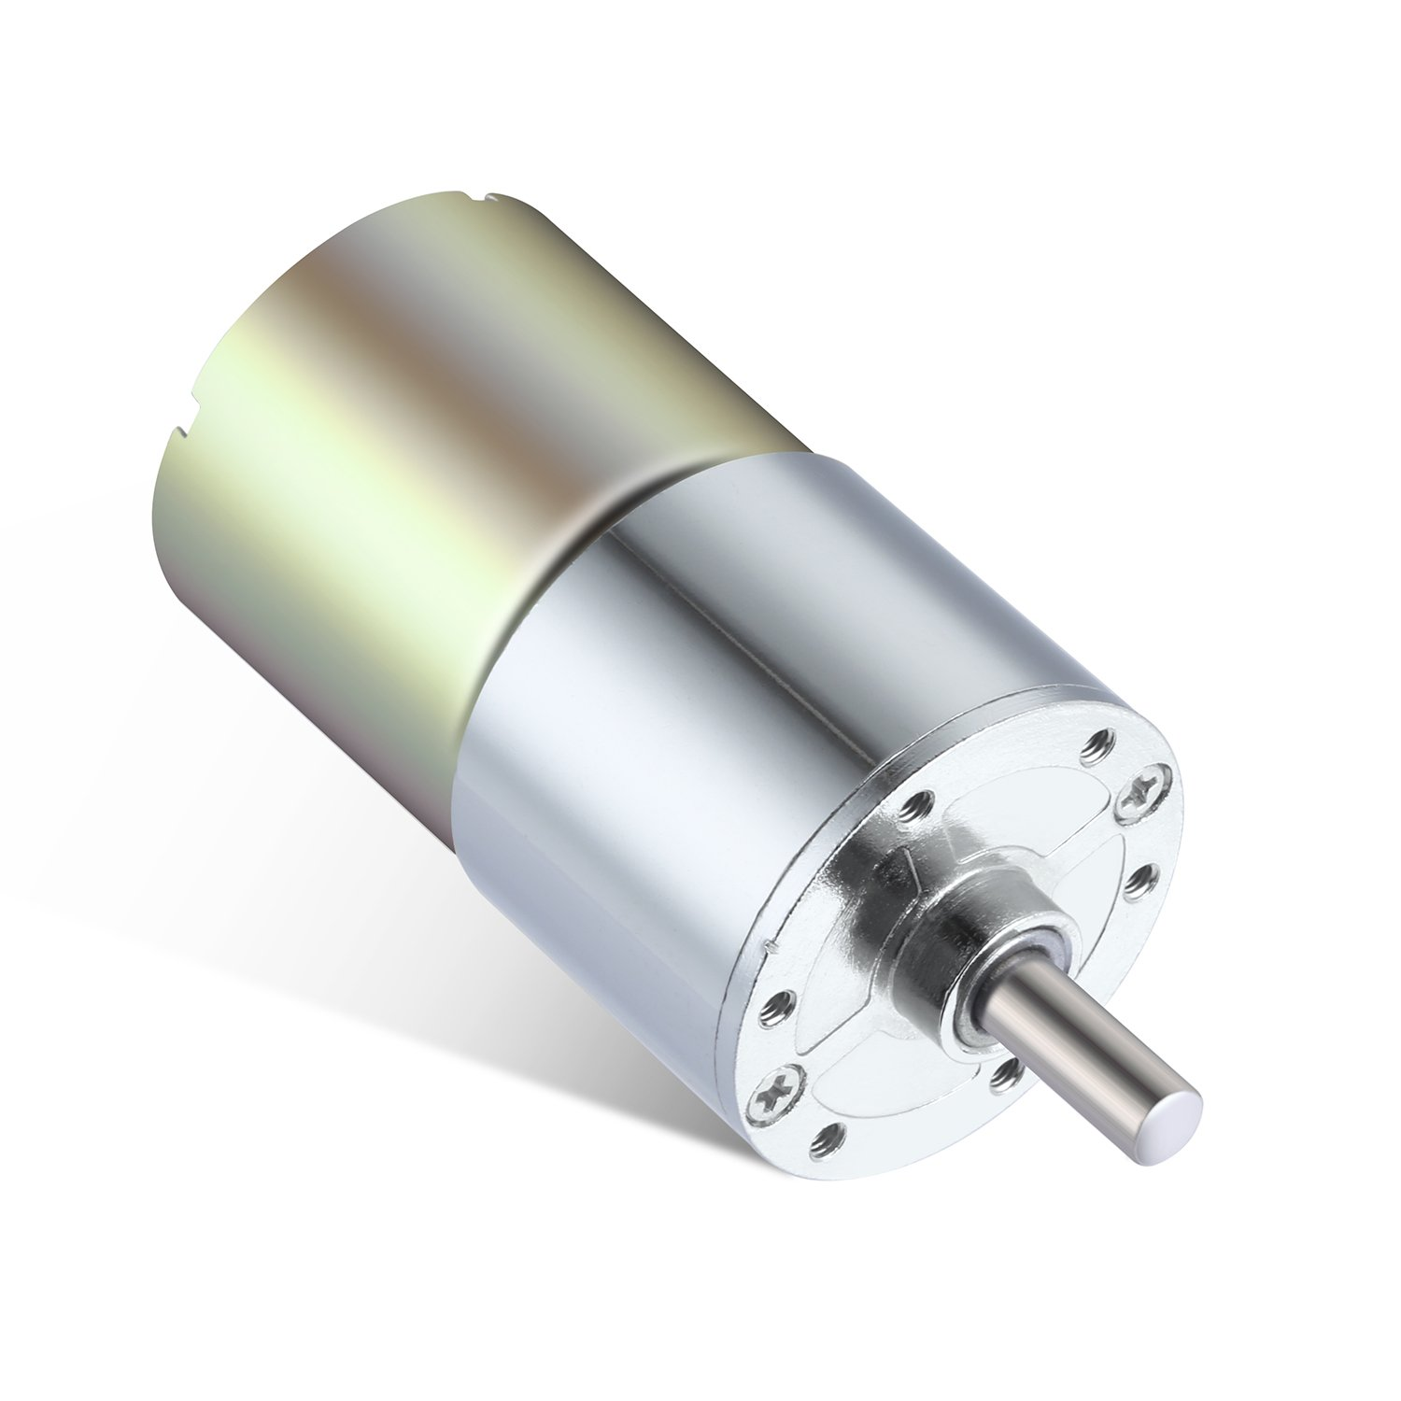
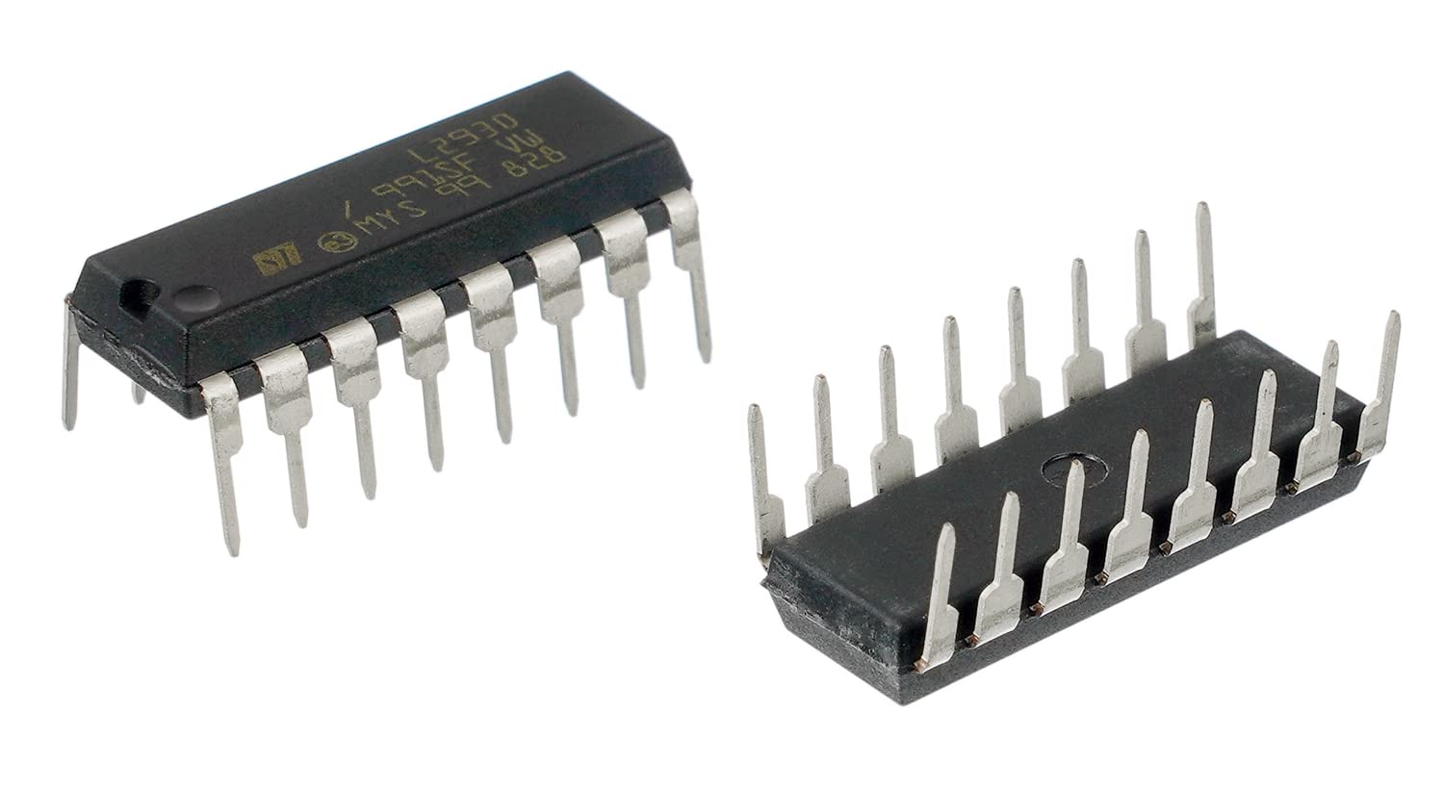
DC Motor and Driver
Selected Model: Greartisan DC 12V 200RPM Gear Motor
12V
200 RPM
Rated Torque: 2.2Kg.cm
Reduction Ratio: 1:24
Rated Current: 0.5A
Use Case: Rotate rollers to dispense cards into the wheel
Use with L293D - BOJACK 16-pin IC Motor Driver
Alternatives considered: AUTOTOOLHOME 6-12V Mini DC Motor (Worse reviews, less documentation), TI SN754410 Motor Driver (Heating Issues)
Notes:
Krish

Slide 21
Major Components

Slide 22
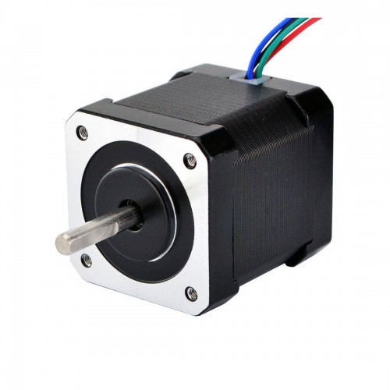
Stepper Motor
 | Low End Servo | Mid Range Servo | Stepper Motor
Price | $12 | $133 (motor/driver combo) | $8.53 + $6.94 (driver)
Material | Plastic | Metal | Metal
Complexity | Low - PWM control | Medium - motor driver | High - homing sequence, motor driver
Power Consumption | Low | High | Medium
Strength | 44.52oz.in stall torque | 2NM holding torque | 77.88oz.in holding torque
StepperOnline 17HS19-2004S1
2A per phase
200 steps per revolution
NEMA 17 stepper motor (1.7 x 1.7in faceplate)
Use Case: Align slots of wheel with feeder and dispenser
Notes:
Craig

Slide 23
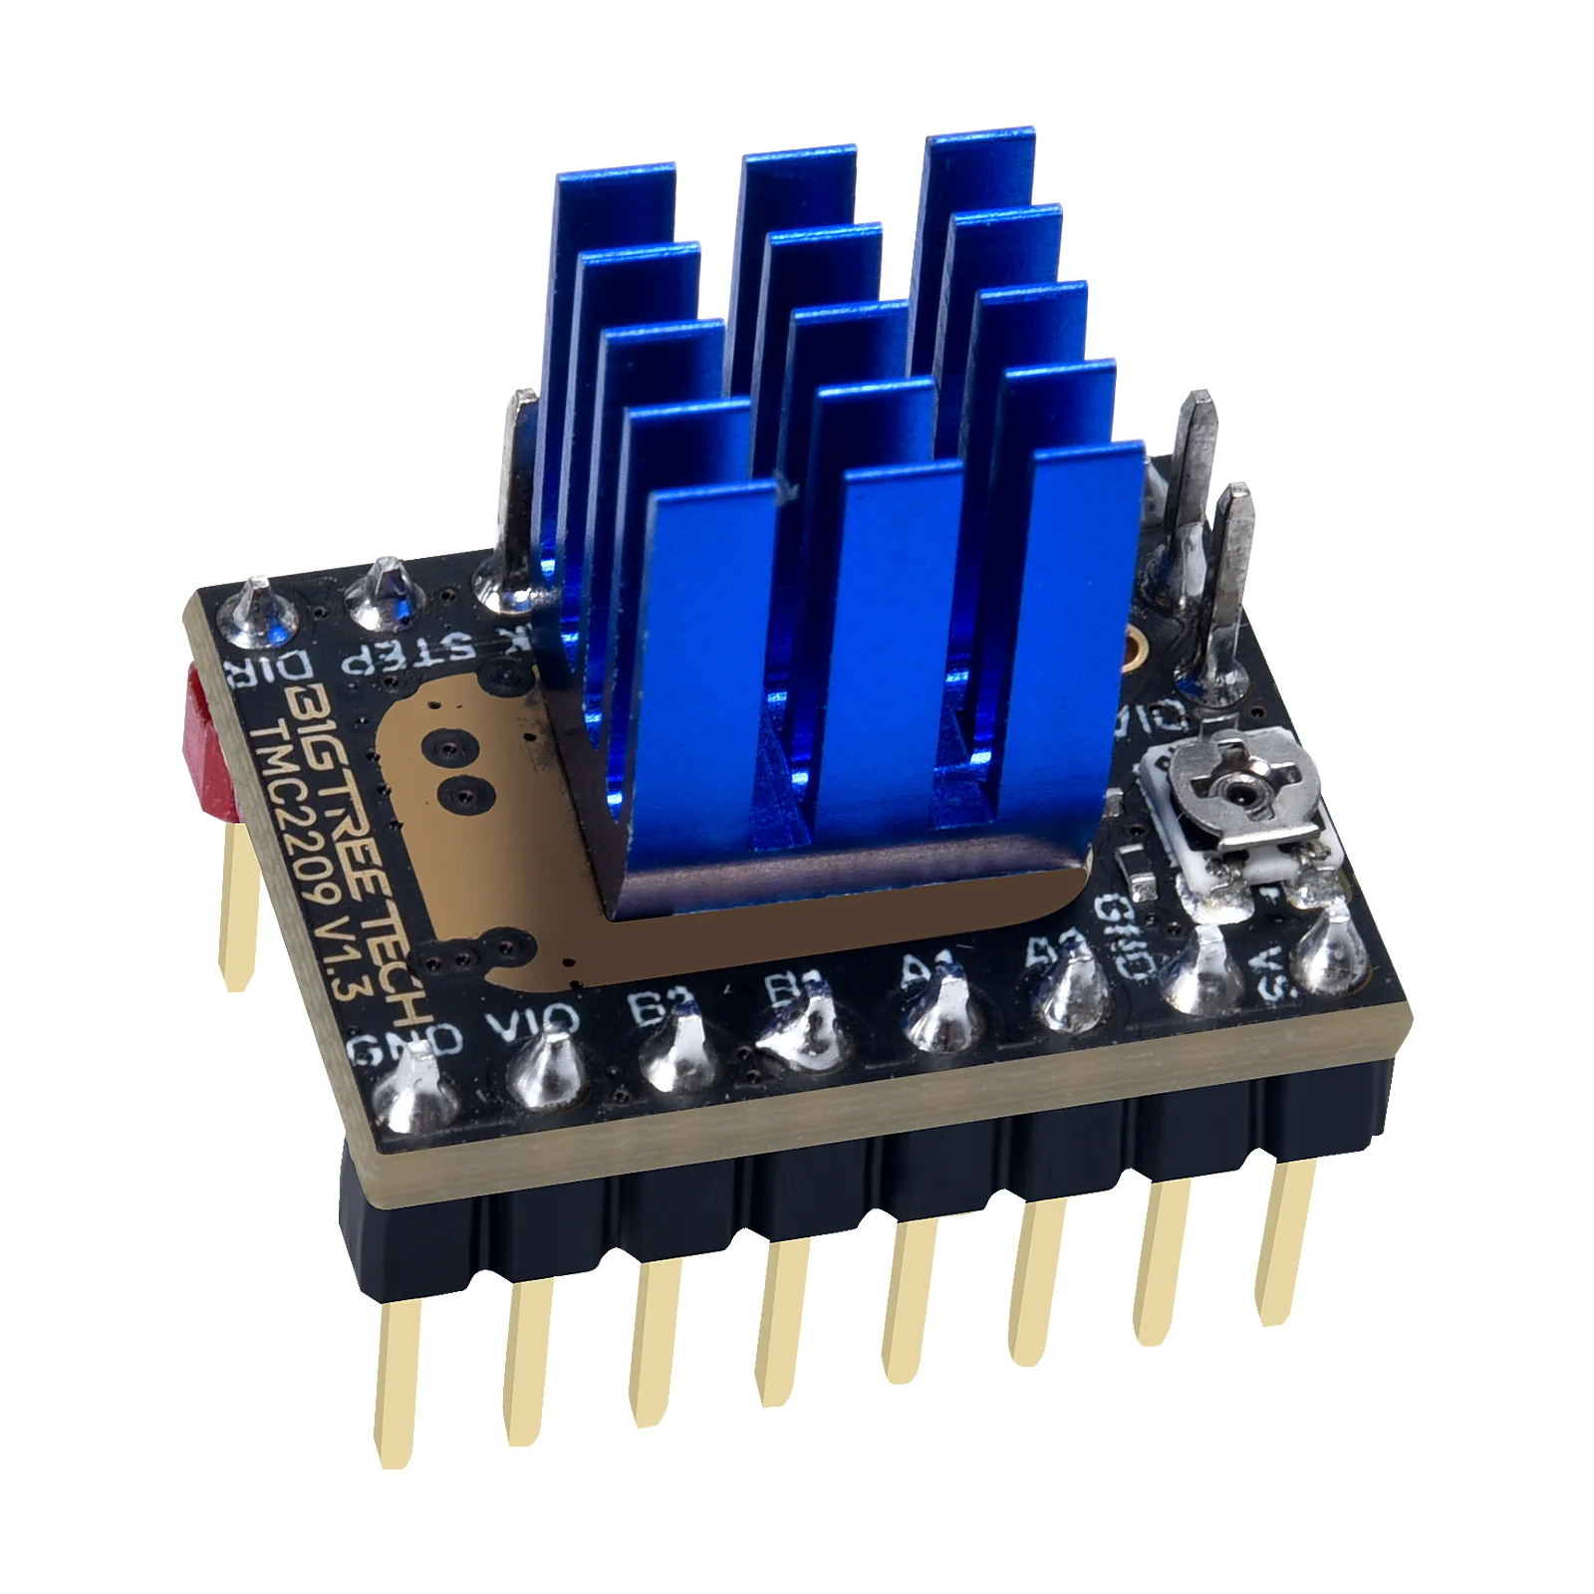
BIGTREETECH TMC2209 Stepper Motor Driver
4.75-28V DC
2.8A peak current
1/16 microstepping
Step/Dir and UART interfaces available
“stealthChop” algorithm for quieter motor movement
Use Case: Accurately control stepper motor
Alternatives considered: DRV8825 and A4988. Both provide lower current output, are louder, and are available for a similar price.
Notes:
Krish

Slide 24
Major Components

Slide 25
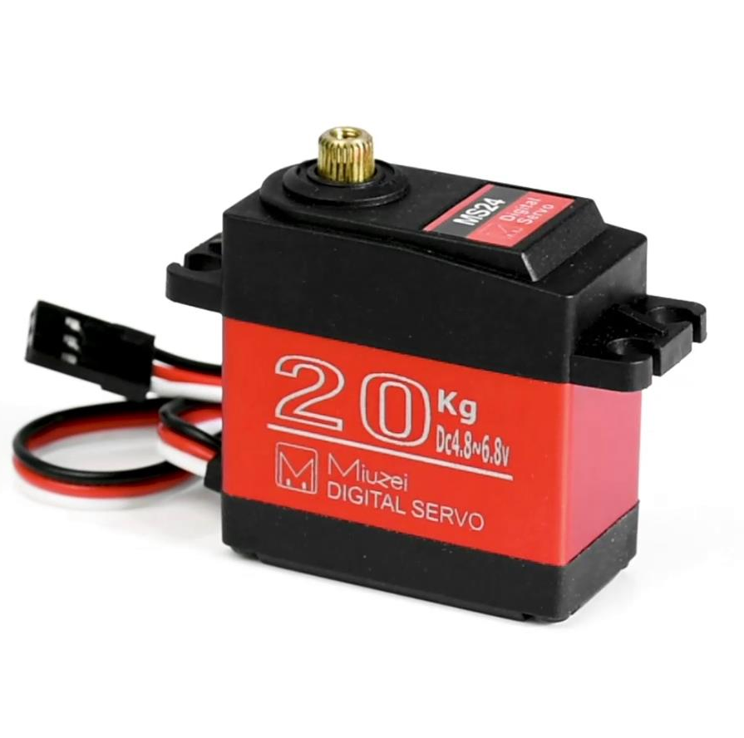
Miuzei DS318 Servo
4.8-6.8V
22.8 kg cm torque
Compatible with 3.3V PWM signal
Position control (rather than continuous servo)
$13.59 (Cheap)
Use Case: Open gate to allow cards to leave wheel
Alternatives considered: Stepper motor (unnecessarily complex / power hungry), Miuzei MS18 servo (less robust), BotBrain continuous rotation servo (less desirable control interface)
Notes:
Krish

Slide 26
Major Components

Slide 27
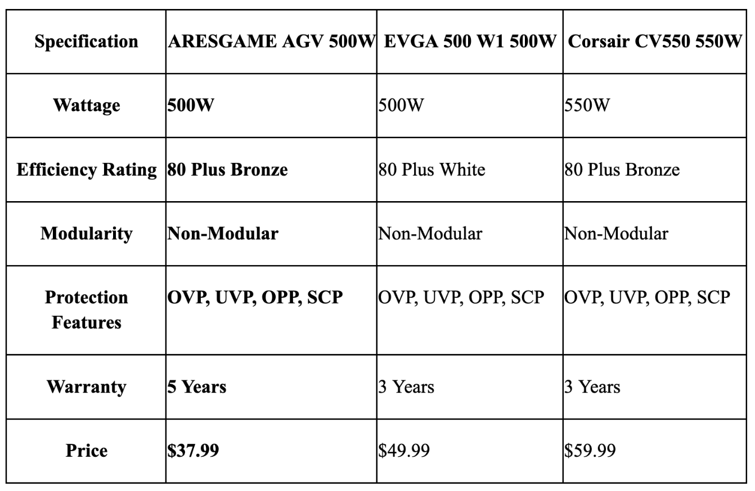
Power Supply
AGV 500W PSU is 80 Plus Bronze certified, ensuring an efficiency of at least 85% under typical loads.
Non-modular PSU was chosen to keep costs low while providing necessary connectivity
Use case: Providing stable, high-current outputs at 3.3, 5, and 12V.
Notes:
Craig

Slide 28
Block Diagram

Slide 29
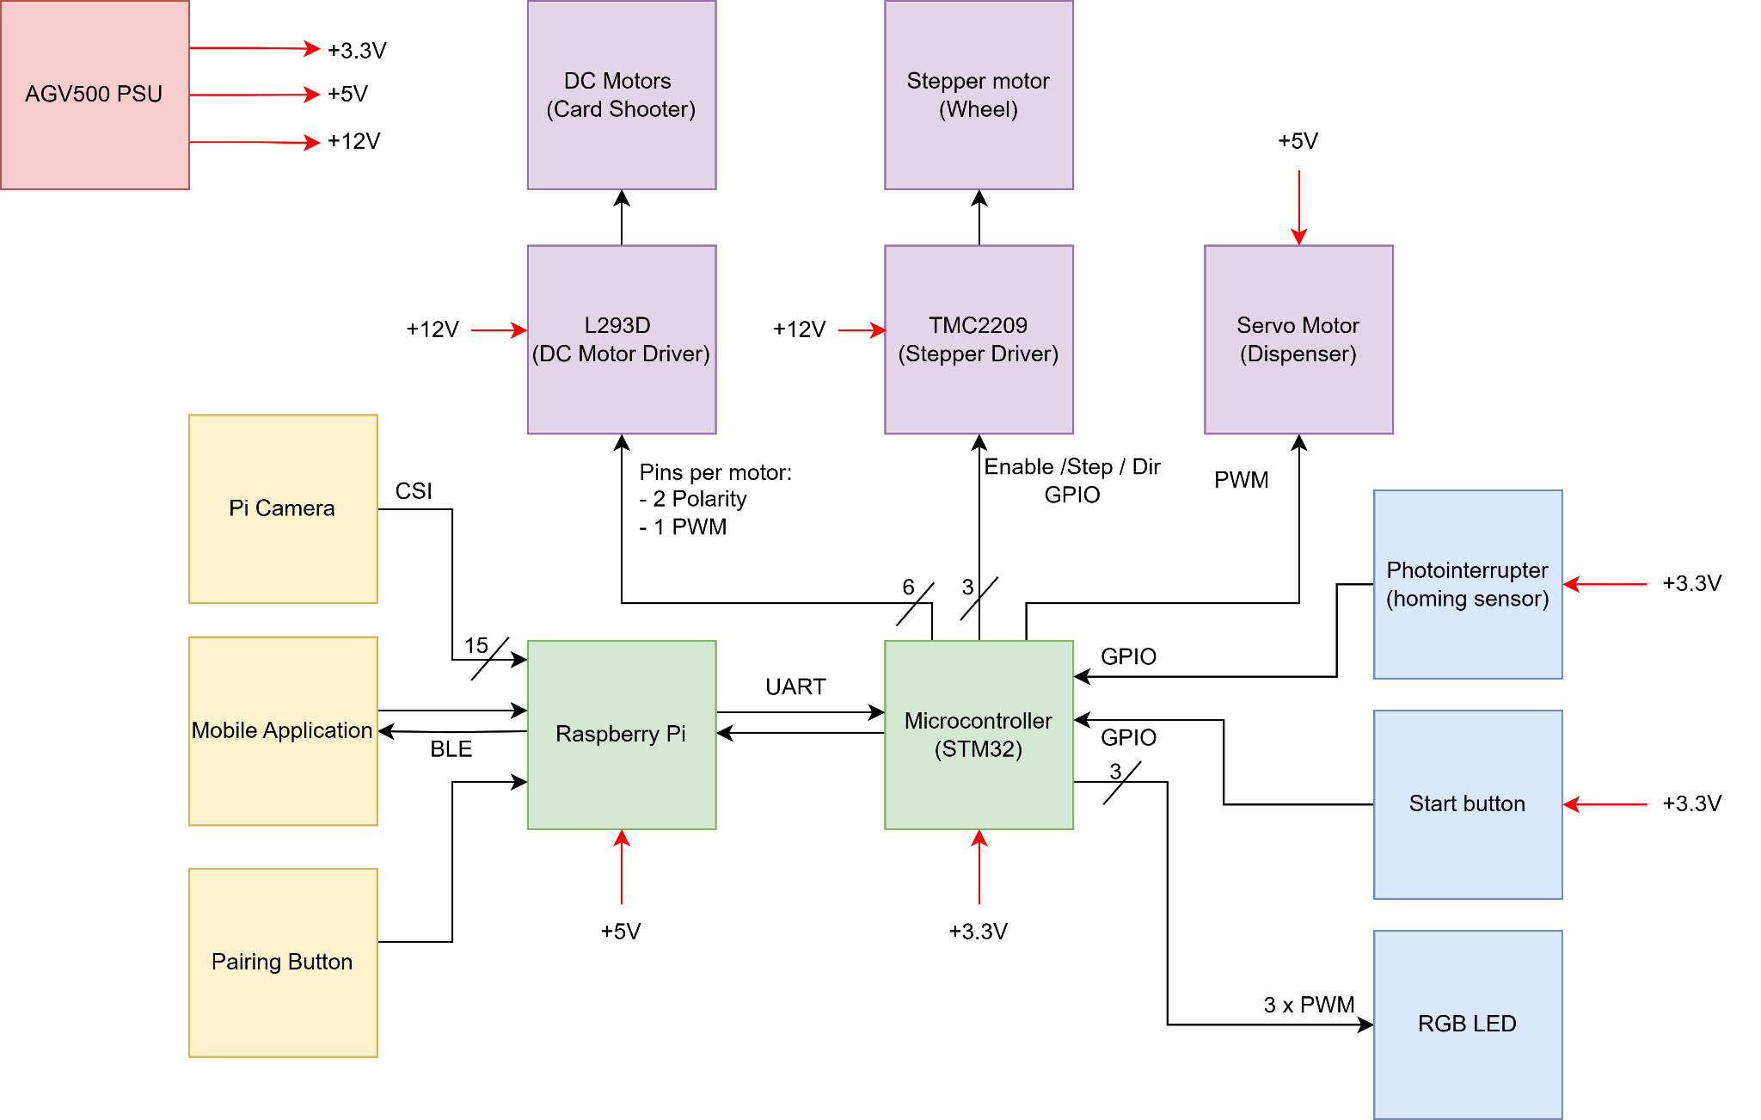
Block Diagram
Notes:
Craig

Slide 30
Packaging Design

Slide 31
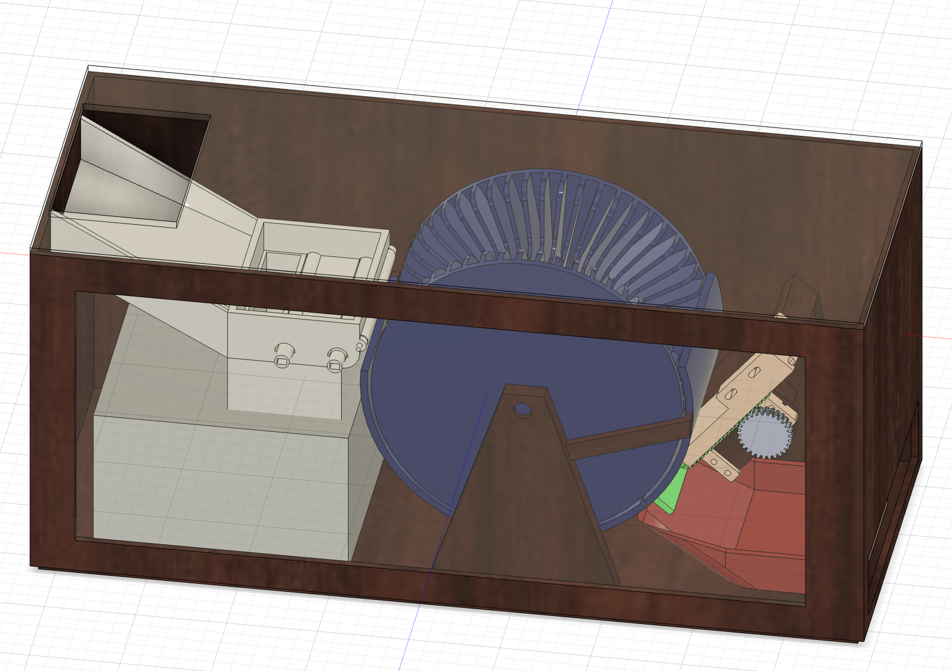
Overall Mechanical Design
Card Wheel
Load Cards
Trap Door
Card Dispenser
Final Deck

Slide 32
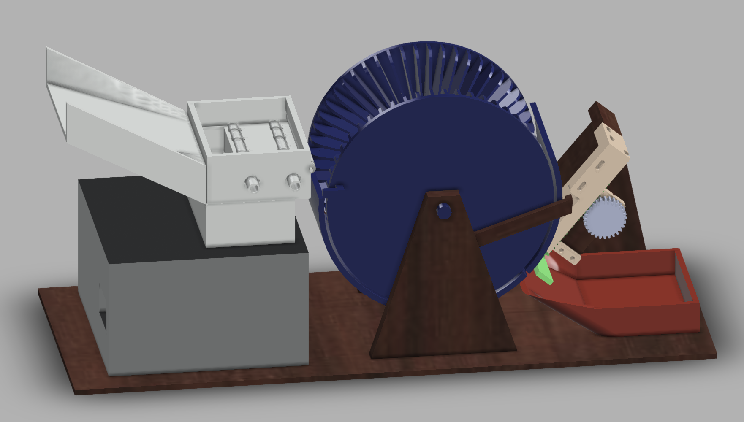
Front View

Slide 33
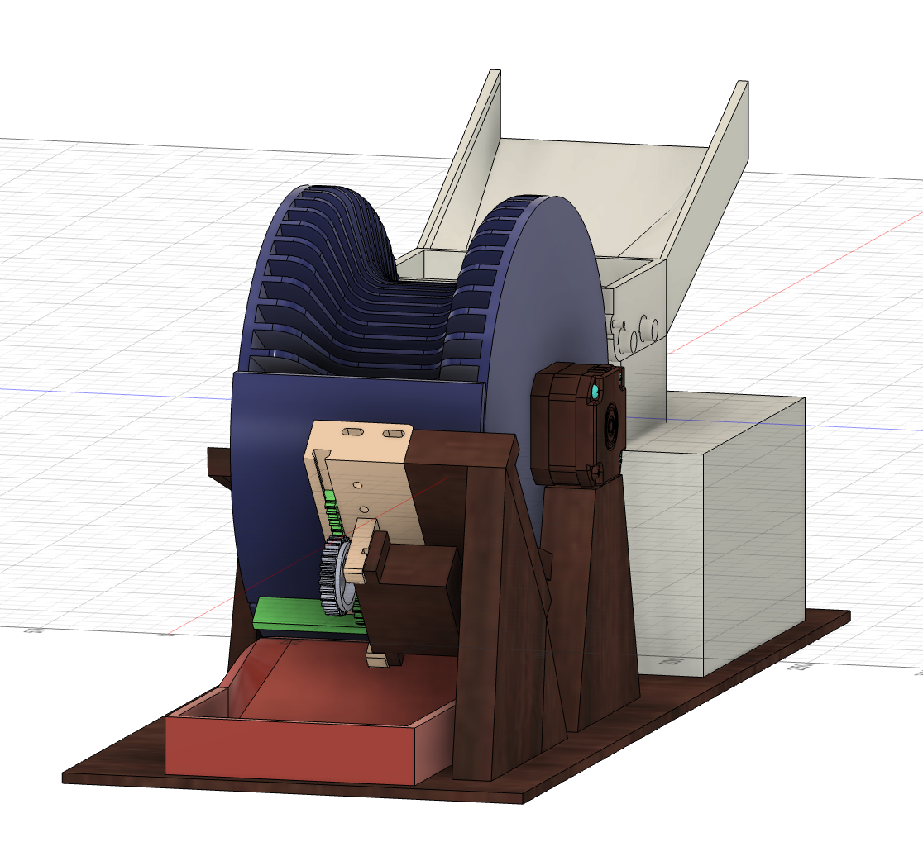
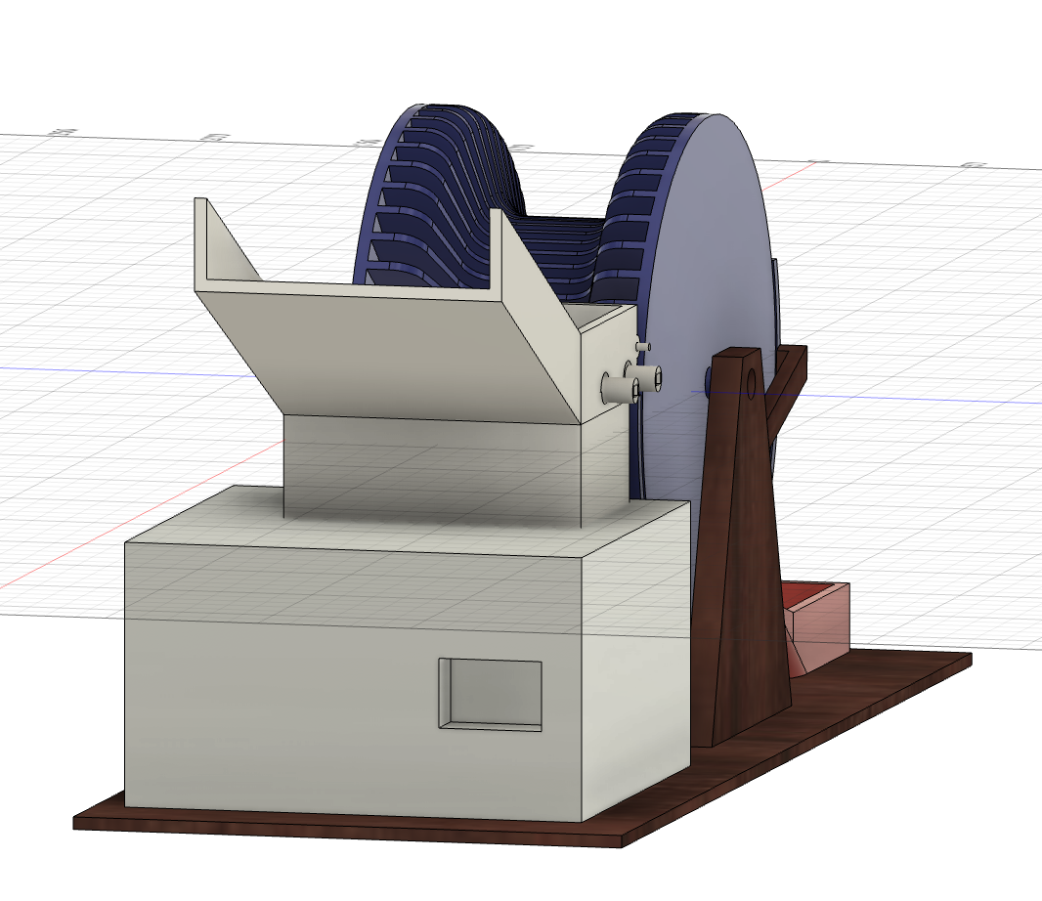
Side View

Slide 34
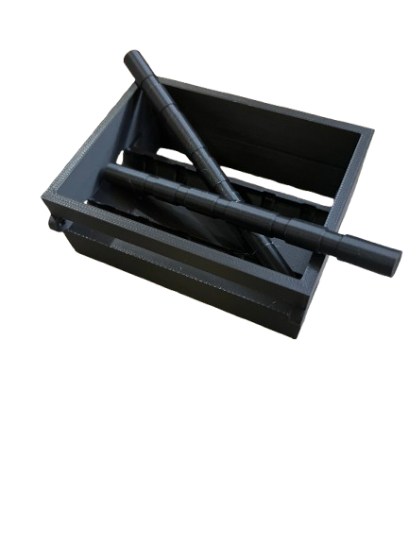
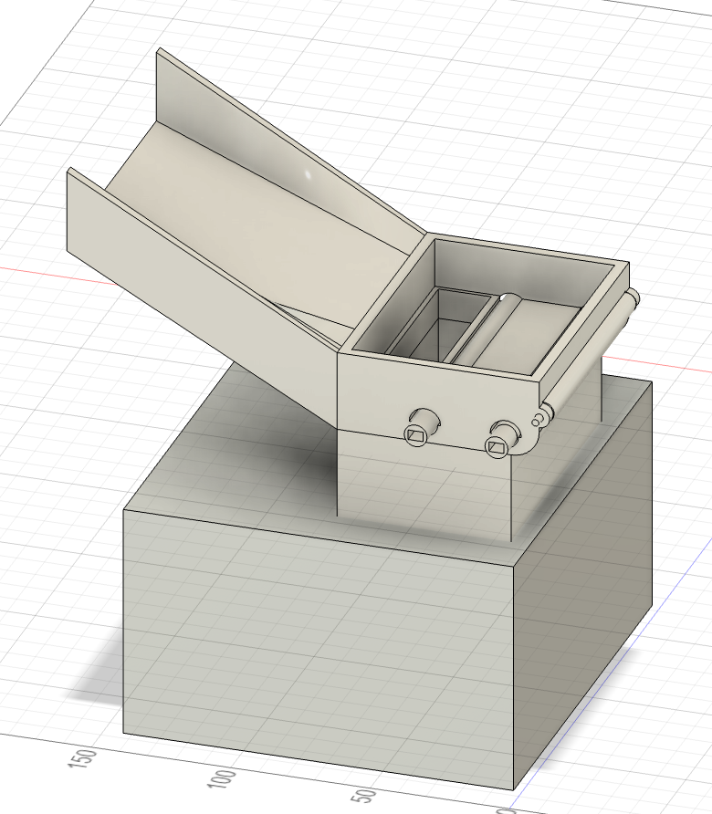
Card Feeding Mechanism

Slide 35
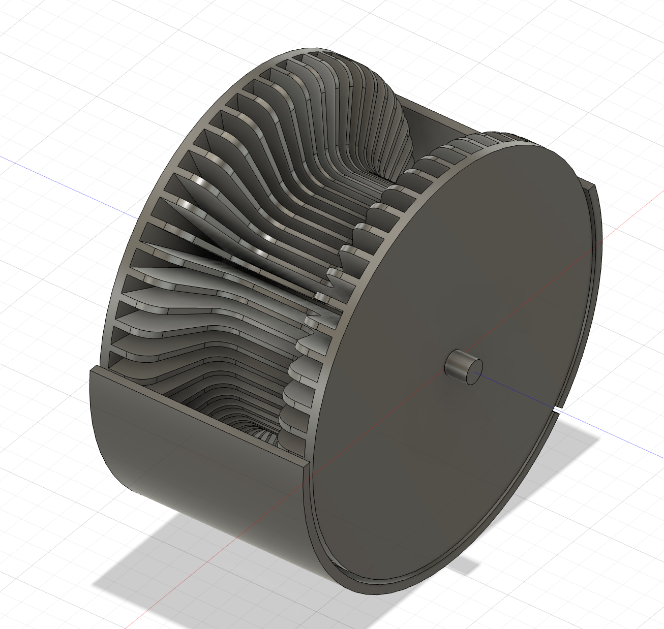
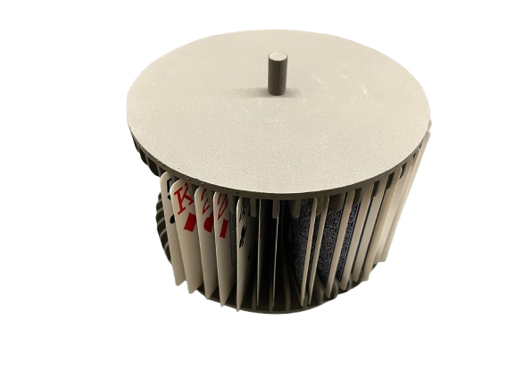
Wheel Design

Slide 36
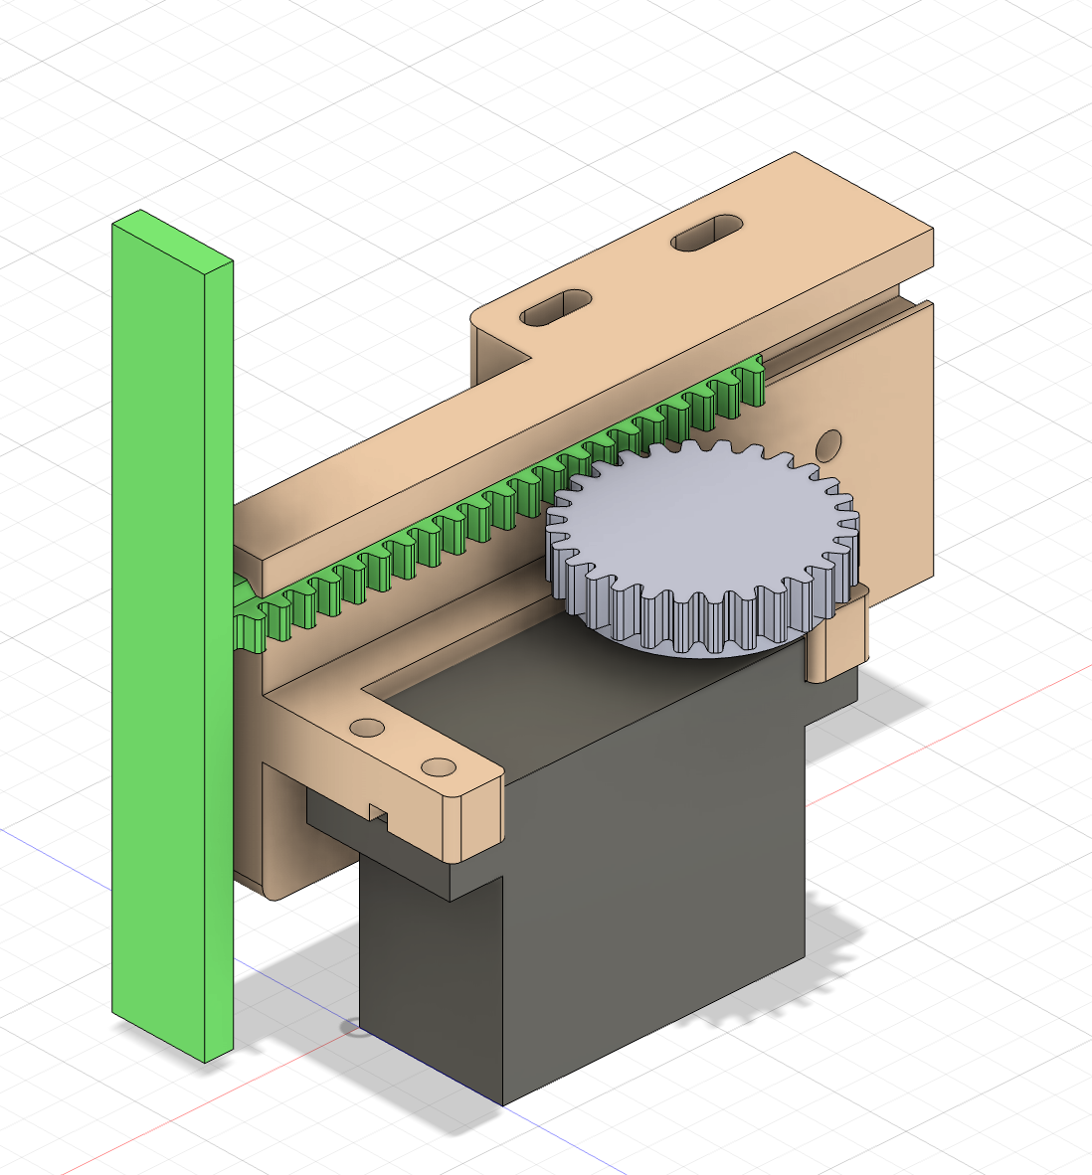
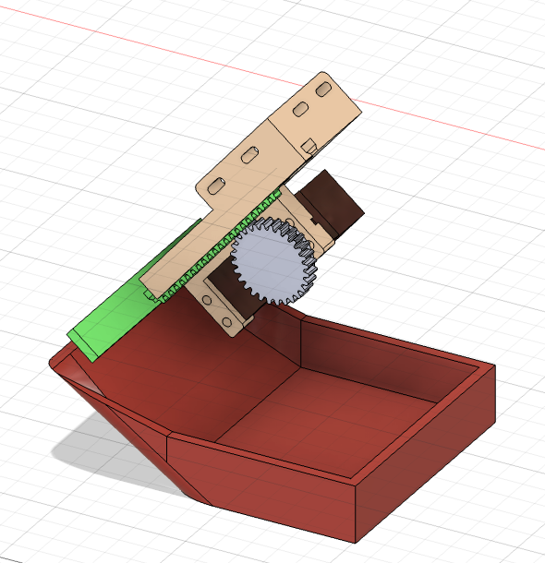
Trap Door Mechanism

Slide 37
Electrical Schematic

Slide 38
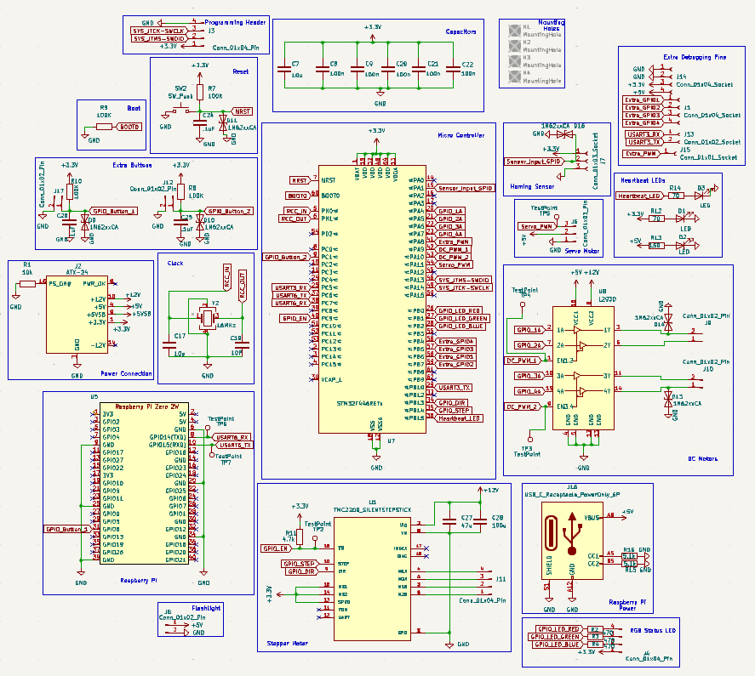
Overall Schematic
Notes:
Johnny

Slide 39
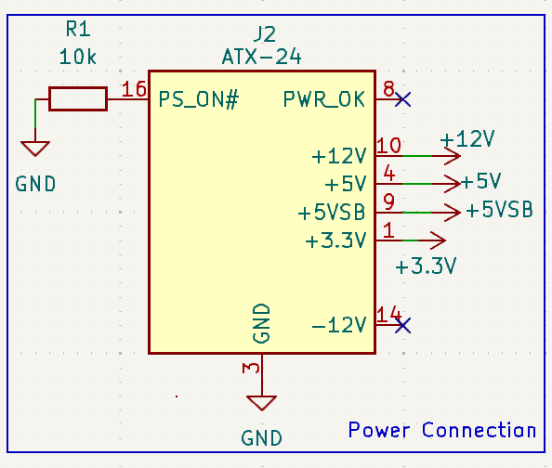
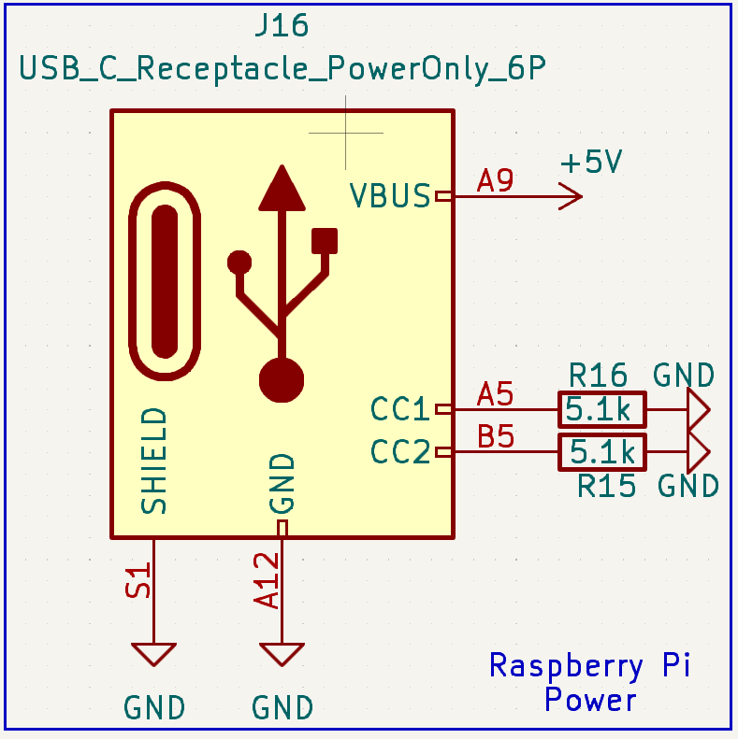
Power Schematic
Notes:
Johhny

Slide 40
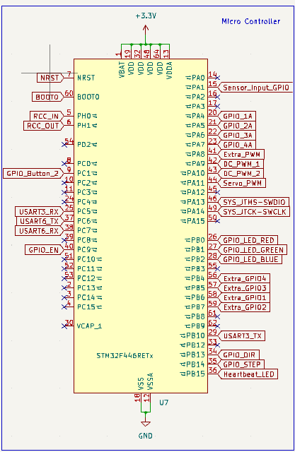
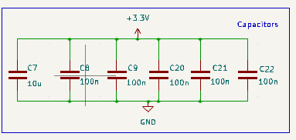
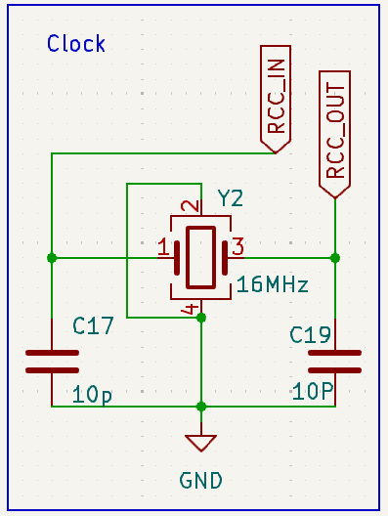

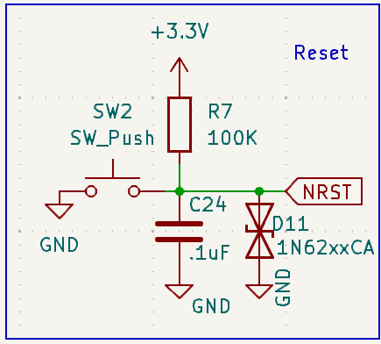
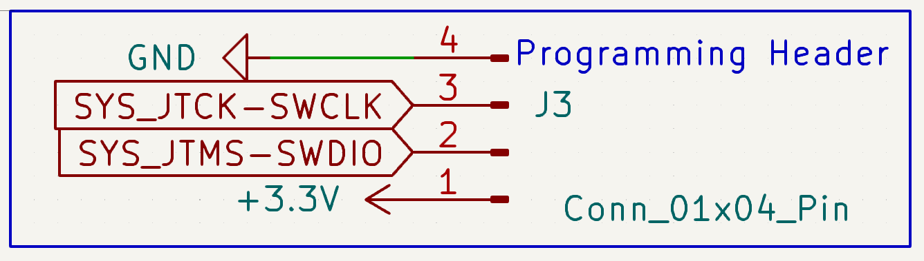
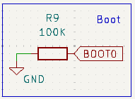
Microcontroller Schematic
Notes:
Johhny

Slide 41
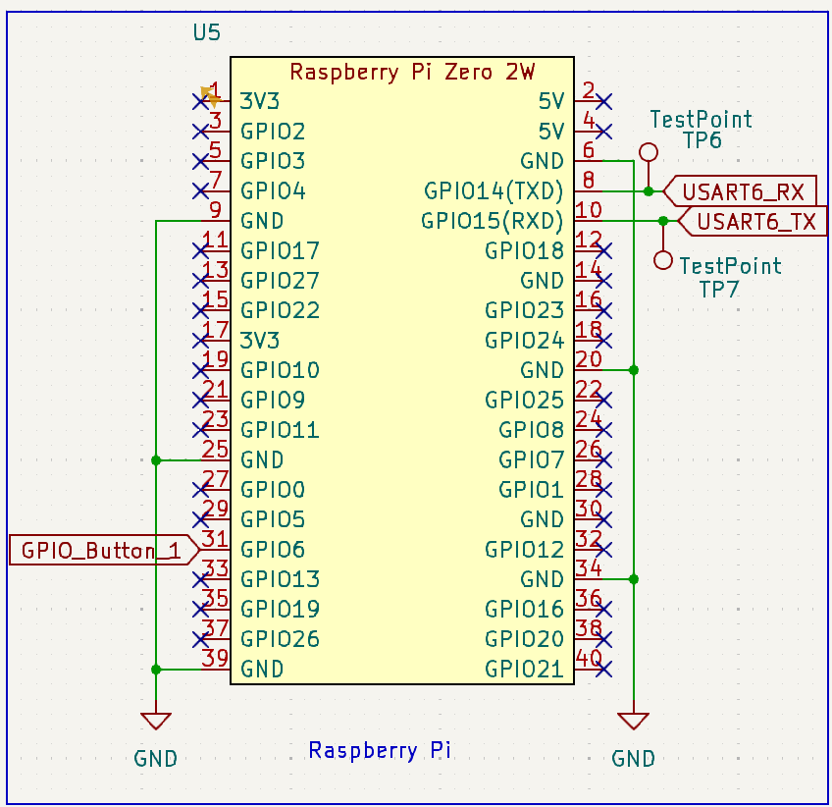
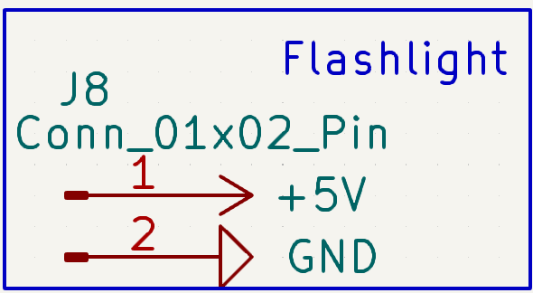
Raspberry Pi Connection
Notes:
Krish

Slide 42
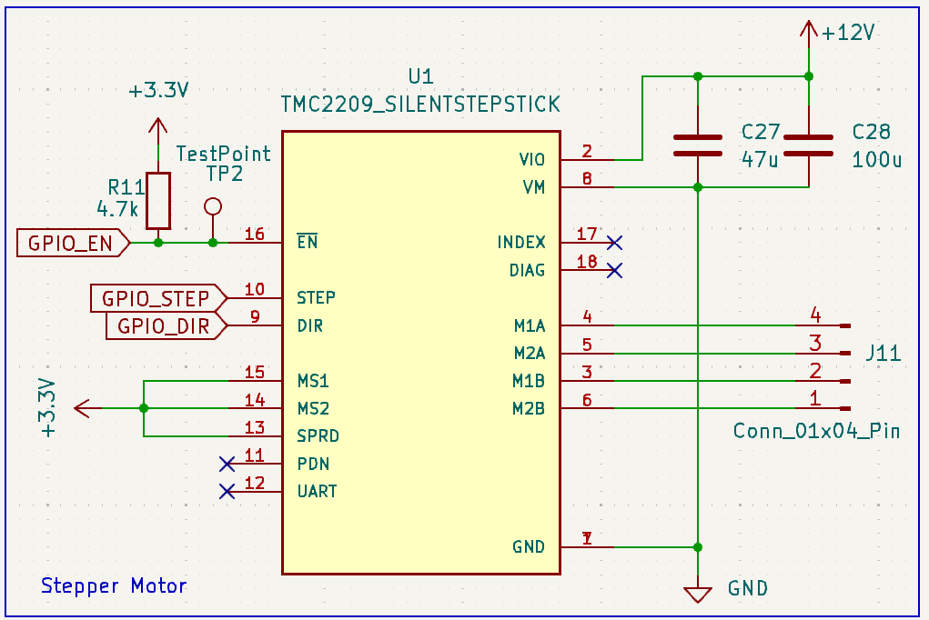
Stepper Motor Connection
Notes:
Craig

Slide 43
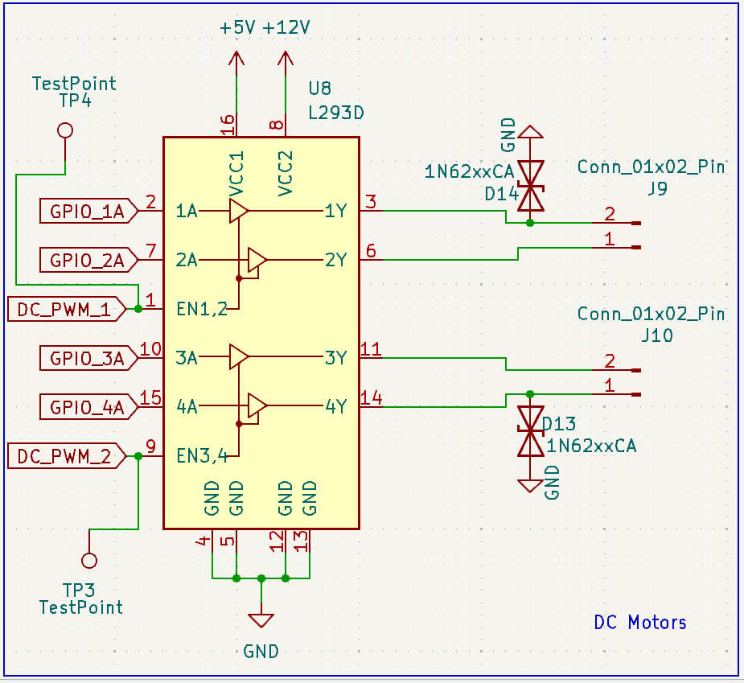
DC Motor Connection
Notes:
Brendan

Slide 44
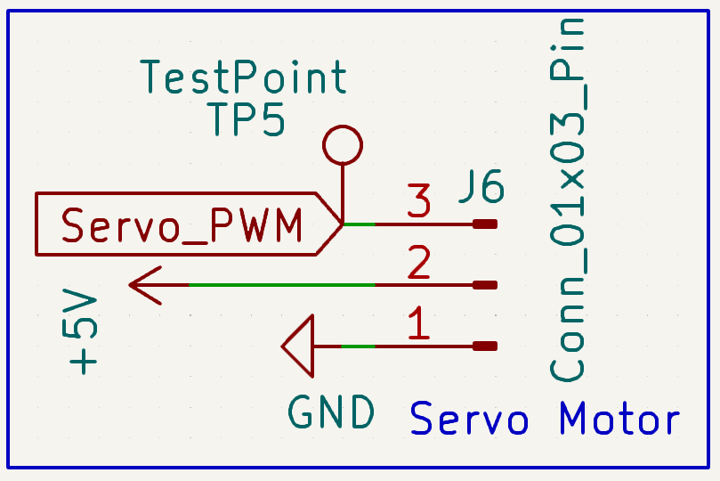
Servo Connection
Notes:
Brendan

Slide 45
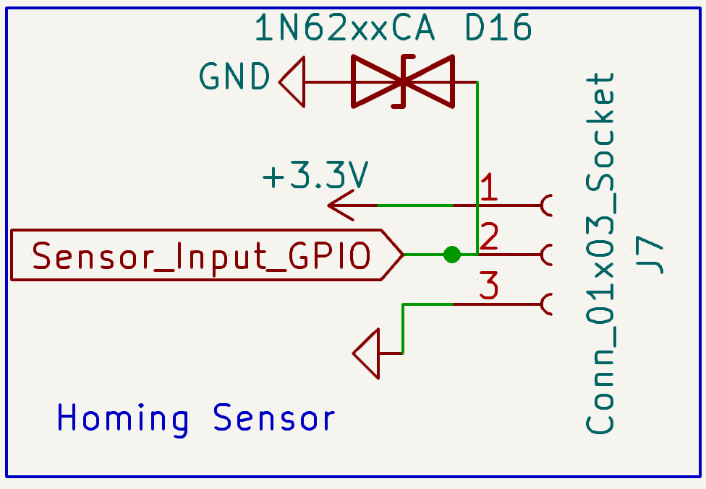
Homing Sensor
Notes:
Craig

Slide 46
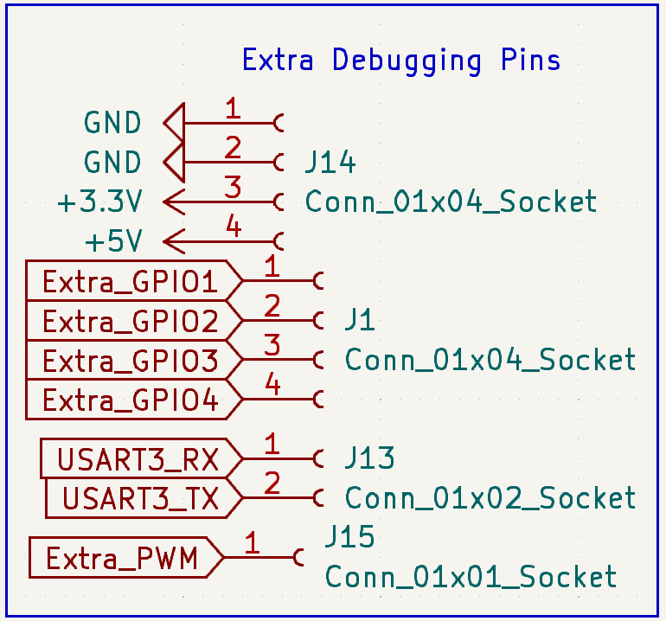
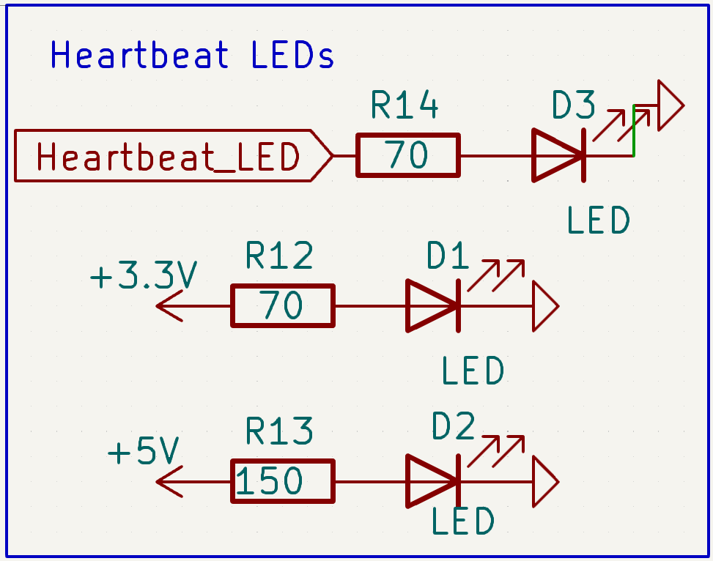
Debugging Connections
Notes:
Johhny

Slide 47
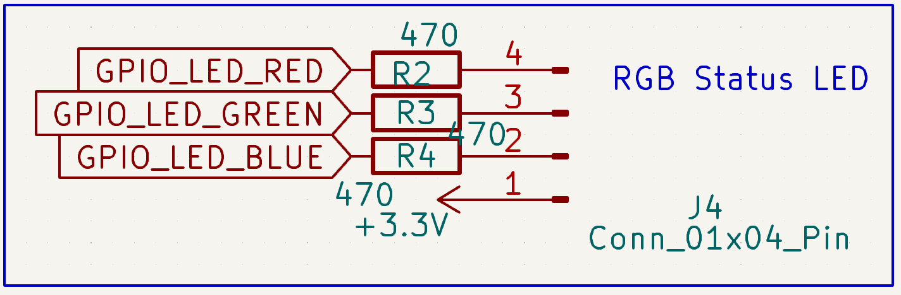
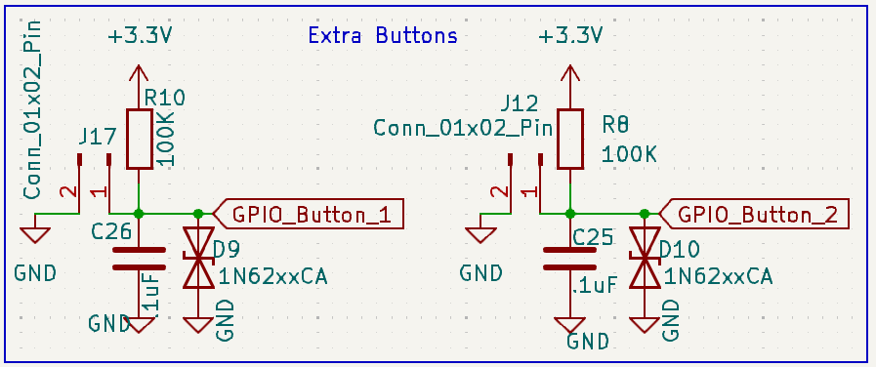
Secondary Connections
Notes:
Krish

Slide 48
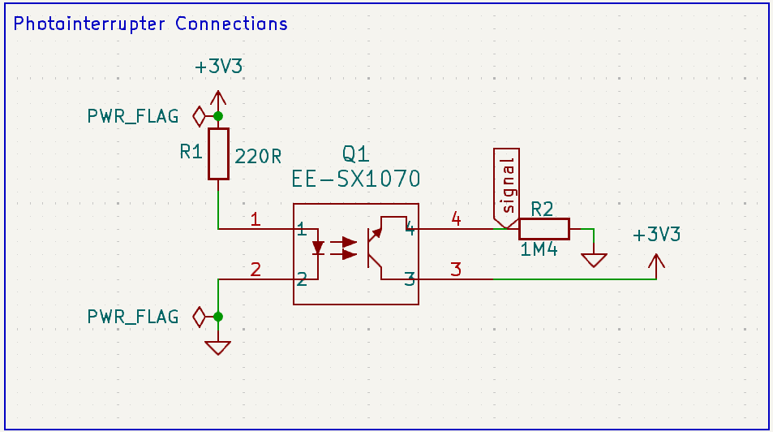

Homing Sensor
Breakout Board
Notes:
Craig

Slide 49
PCB Layout

Slide 50

PCB Information
PCB Informations
Fixed in placed with 4 M2 Screw mounting holes
4 layers:
  Front layer
  GND
  PWR(3.3V)
  Back layer
Dimensions:
  Width: ~73 mm
  Length: ~73 mm
Notes:
Johhny

Slide 51

Overall PCB
Notes:
Johhny

Slide 52


Power PCB
Type-C
Notes:
Johhny

Slide 53


Microcontroller PCB
Programmer
Notes:
Johhny

Slide 54



Raspberry Pi PCB
Button
Flash light
Notes:
Johhny

Slide 55

Stepper Motor PCB
Notes:
Johhny

Slide 56

DC Motor PCB
Notes:
Johhny

Slide 57

Servo PCB
Notes:
Johhny

Slide 58




Secondary Pins PCB
Extra GPIO
Notes:
Johhny

Slide 59


Secondary Pins PCB
Power LEDs
Notes:
Johhny

Slide 60

Homing PCB
Notes:
Craig

Slide 61

3D Design
Notes:
Johhny

Slide 62



Footprint Verification,
DRC & ERC
Notes:
Johhny

Slide 63




Homing Sensor Breakout PCB
Notes:
Johhny

Slide 64
Prototyping Progress

Slide 65
Current Progress
Software
Electrical
Mechanical

Slide 66
Current Progress
Software
Electrical
Mechanical

Slide 67

Mechanical Progress
All CADing finished (minor tweaks perhaps required)
Printed Parts
Wheel - SLS Printing
Card Dispenser - PLA
Trap Door Servo - PLA
To be Printed / Manufactured
Laser cut outer casing
Wheel Support
Power Supply and PCB Cover
Notes:
Johnny

Slide 68
Current Progress
Software
Electrical
Mechanical

Slide 69
Features Implemented
Random Shuffle*
Poker
  User selects pocket and common cards
  Poker Game Mode (run game modes with probabilities)
  Random Shuffle Notify (Returns winner)
  Poker Mods
    No Pocket Pairs
    Guaranteed Unsuited 2-7 Win
    Showdown Mode (2 Players with straight or higher)
Custom Mode
  Unopened pack, separate both colors, specific card on top, palindrome, give time, give phone number*
*Time Optimized
Notes:
Krish

Slide 70
Presort vs Postsort
Presort - Have defined order of cards before loading in; Load cards to correct position, unload one by one
Post Sort - Load cards in adjacent slots; Generate unloading order; unload cards based on order
Worst Case Time Complexity: Approximately Equal
Best Case Time Complexity: Post sort is faster -> Time optimization
Features: Post Sort, if one mode works, every would work
Final Decision: Post Sorting
Notes:
Krish

Slide 71

Feature Demonstration
Worst Hand Winner (3 Player Mode)
Winning Hand: Full House
Showdown Mode
2 Flushes
Random Shuffle Inform (5 Player Mode)
Winning Hand: King Pair
Notes:
Krish

Slide 72

High Level Software Progress
Notes:
Krish

Slide 73

Low Level Software
Prototyped Software:
Stepper Motor
Servo Motor
Photointerrupter for motor homing
UART connection between Pi and STM32
Bluetooth connection between Pi and external device
Software Needed:
Pi Camera image classification
DC Motor Control
Button debouncing to start sorting
Notes:
Brendan

Slide 74
Connection Software
UART Connection
Connects Pi and STM32 via two separate UART lines
Simplest possible connection for 1 byte data transfer
1 byte, no parity bit, 1 stop bit
Used for ready signals, motor positioning
Bluetooth Connection
Connects Pi and mobile app
Loads user configuration via JSON to Pi
GATT server running on Pi provides UUID endpoints
Based on open-source project
Must use GATT server to force BLE for cross-device compatibility
Notes:
Brendan

Slide 75

UART Demonstration
Notes:
Brendan

Slide 76
Connection Software
UART Connection
Connects Pi and STM32 via two separate UART lines
Simplest possible connection for 1 byte data transfer
1 byte, no parity bit, 1 stop bit
Used for ready signals, motor positioning
Bluetooth Connection
Connects Pi and mobile app
Loads user configuration via JSON to Pi
GATT server running on Pi provides UUID endpoints
Based on open-source project
Must use GATT server to force BLE for cross-device compatibility
Notes:
Brendan

Slide 77
Bluetooth Demonstration
Notes:
Brendan

Slide 78
Current Progress
Software
Electrical
Mechanical

Slide 79

Wheel - Stepper Motor
Notes:
Craig
Add video

Slide 80
Servo - Trap Door Mechanism
Notes:
Craig

Slide 81

Card Dispensing
2 DC Motors
Dispense 1 card at a time
Notes:
Krish

Slide 82
Software Development Status

Slide 83


STM32 Functionality Status
Notes:
Craig

Slide 84

Raspberry Pi Status
Notes:
Brendan and Krish

Slide 85

Notes:
Krish

Slide 86

Notes:
Brendan

Slide 87

Notes:
Brendan

Slide 88

Notes:
Krish

Slide 89
Project Timeline

Slide 90

GANTT CHART
Notes:
Krish

Slide 91
Q/A Time

Slide 92
Thank You!!!
Happy Cereal and Flapjack Day!

